Slide 1
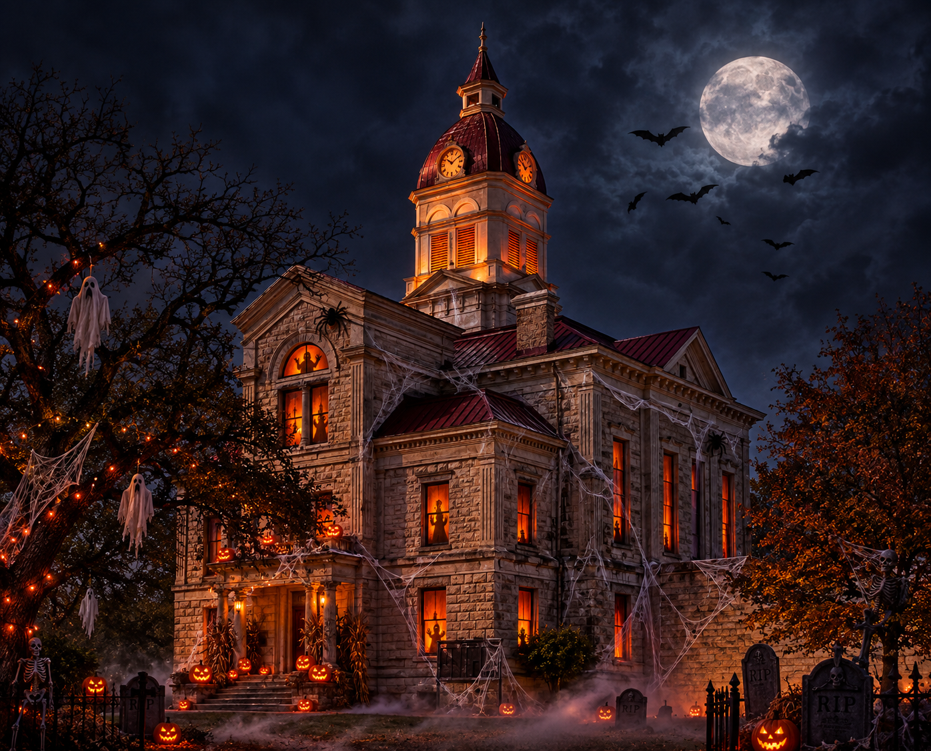

Bandera Marshal’s Office Presents
NIGHTMARE ON
MAPLE STREET
OCT. 31ST
5-7PM
AT BANDERA CITY PARK
TRUNK-OR-TREAT
DOOR PRIZES
COSTUME CONTEST
BEST TRUNK CONTEST
BOUNCE HOUSE
FACE PAINTING
AND MORE
FOR PARTICIPATION, DONATION, OR SPONSOR INFORMATION CONTACT EARL HEIDELBERG AT 830-460-7172

